Slide 1
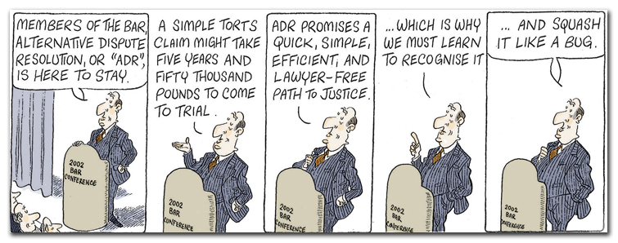
Alternative Dispute Resolution

Slide 2
Things you need to know…
What is ADR
The 4 main types of ADR
The need for it in society

Slide 3
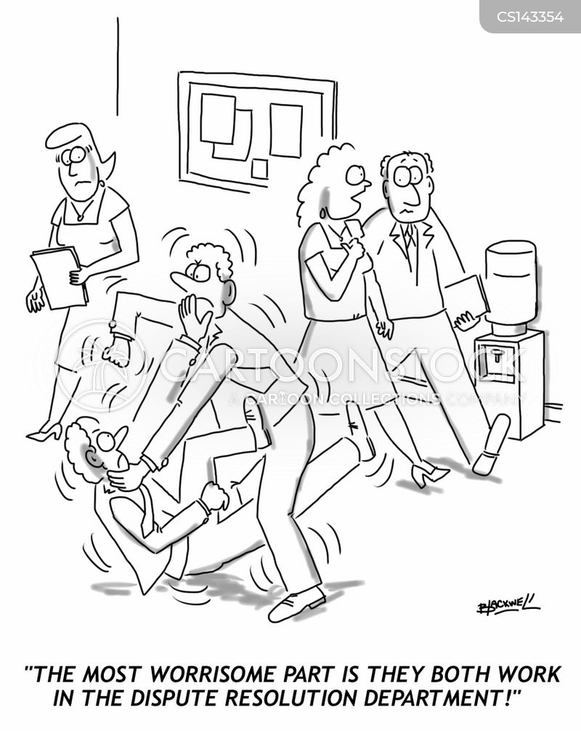
What are disputes?
Disputes are possible between many types of individuals
Statutory and common law recognise that companies are treated as individuals in the eyes of the law
Private and Public companies are individual legal entities and can be the subject of legal disputes
Federal, State and Local governments are also distinct legal entities
The procedures and rules for disputes against these are the same as for individuals

Slide 4
What are some common disputes IN LAW?
Write down as many as you can….
Examples:
Uncompleted contractor job (broken contract)
Car accident (no one takes responsibility)
Neighbour dispute
Disagreement with Centrelink payments
Immigrant being deported
Someone got sick drinking manufactured product (negligence)

Slide 5
What are some common disputes?
State bringing criminal charges against oil company for breach of H&S legislation
Surfer sues local council (negligence in not telling him of dangerous conditions)
Lawyer wants to sue for defamation
Child dies in hospital (negligence)
Husband and wife wish to be divorced and have custody issues with children and separation of stuff

Slide 6
Criminal v Civil
Note, there were criminal and civil disputes in that list
What is a civil dispute?
Often referred to as a private dispute – involves 2 or more individuals in a community
They may use the court system to solve their dispute (provided by State, but State is not involved)
What is a criminal dispute?
Often referred to as a public dispute – always involves the State as a direct participant (WA = police force and Office of Public Prosecutions, they are responsible for prosecution of all criminal cases in court)
Why is it called public dispute?
Public officials and public protection

Slide 7
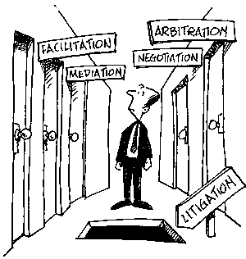
Introduction to ADR
Court system can be inefficient or provide ineffective resolutions for disputes between individuals
People turn to other avenues…
Alternative Dispute Resolution is often referred to as ADR.
It describes the ways that parties can settle disputes with the help of an independent third party and without the need for a formal court hearing – operates outside court system

Slide 8
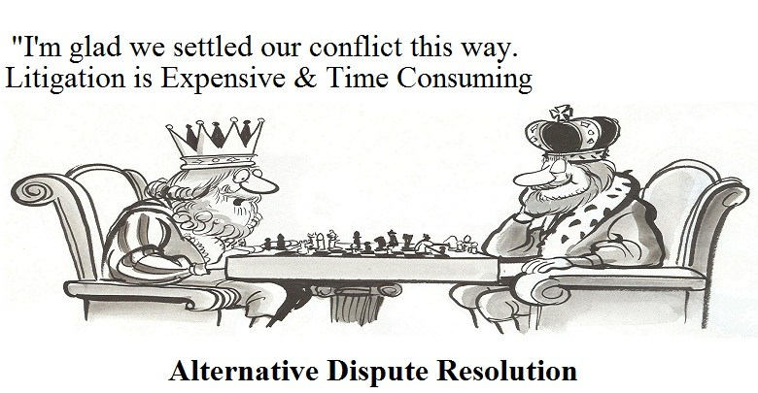
What are the options available to people?
Envelope, 1 between 2/3
Match the type of ADR to the description, good luck ☺

Slide 9
Main types of ADR
Negotiation
Mediation
Conciliation
Arbitration

Slide 10
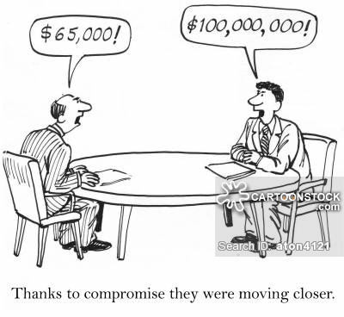
NEGOTIATION
Individuals do not rely on the courts, or on legal professionals
Most minor disputes are solved this way, even some major disputes
E.g. car accident, negotiate how repair costs are shared
E.g. neighbour talks through issues
Parties may consult expert guidance such as a surveyor
It can involve lawyers if a party doesn’t feel their views are being represented
Negotiation can continue through formal legal proceedings

Slide 11
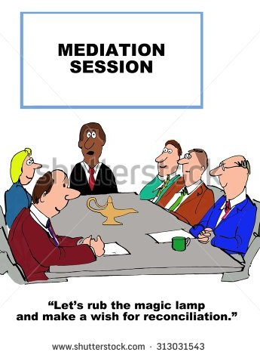
MEDIATION
Parties in a dispute may refer their dispute to an independent third party who will act as a go-between.
Sorting out dispute with minimal conflict – MOST COMMON
The mediator will help the parties discuss their dispute in order to try to settle it.
Voluntary participation in a confidential process
The mediator assists parties to identify issues in dispute and explore options and alternative resolutions
The parties must agree on a settlement
The settlement has the same force of a contract and is binding

Slide 12

Mediation Steps
Meet in a neutral space with mediators present
Parties have a chance to state point of view, mediator asking leading questions
Mediator reads back the main points, establishing an agreed summary of party’s positions (written on white-board)
Parties explore issues raised in statement
Parties meet independently with mediator in a private session and given advice about options for settlement (or costs of continuing dispute). They reconsider and reflect
Parties meet and brainstorm solutions that provide mutually acceptable settlement

Slide 13
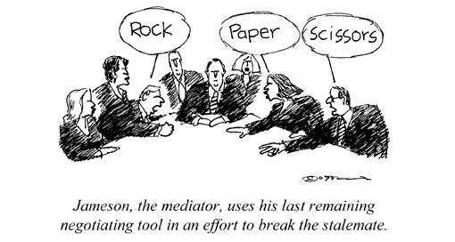
Refusing Mediation
Almost all civil cases in WA Supreme Court are required to undergo mediation before a formal trial can commence
If parties in litigation refuse an offer to mediate without good reason then even if they win their case in court, the judge can refuse to award them some or all of their legal costs.

Slide 14
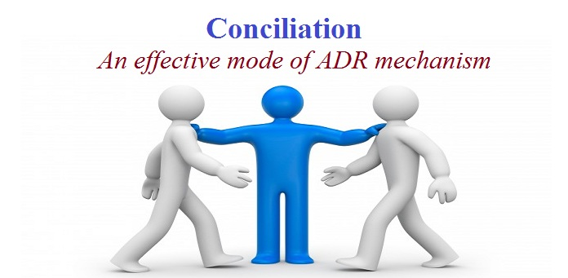
Conciliation
Conciliation is an informal, flexible approach to resolving complaints – matters can be settled by an exchange of letters, a telephone conciliation conference or a face to face conciliation conference.
Very similar to mediation except the conciliator has a much more involved role (makes suggestions e.t.c)

Slide 15
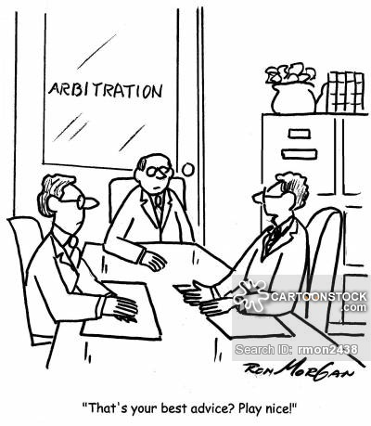
ARBITRATION
Arbitration is the adjudication of a dispute by one or more specially-appointed experts or lawyers (arbitrator)
The rules are set by statute – final decision (treated in same way as a court decision)
Decision cannot be appealed to courts however unless there was an error in decision-making
More formal than mediation, can be quite costly
People who work as arbitrators often belong to the Chartered Institute of Arbitrators.
Arbitration is governed by legislation such as Commercial Arbitration Act 2012

Slide 16
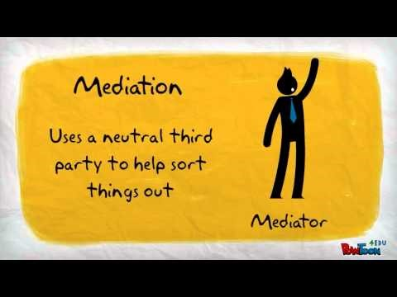

Slide 17
Exercise
What do you think are the advantages and disadvantages of Alternative Dispute Resolution?

